Slide 1
^{CeOS_SE}
^{Citizen Science Network} ^{in Slovenia}
Mitja V. Iskrić
^{Zagreb, 30th October, 2024}

Slide 2
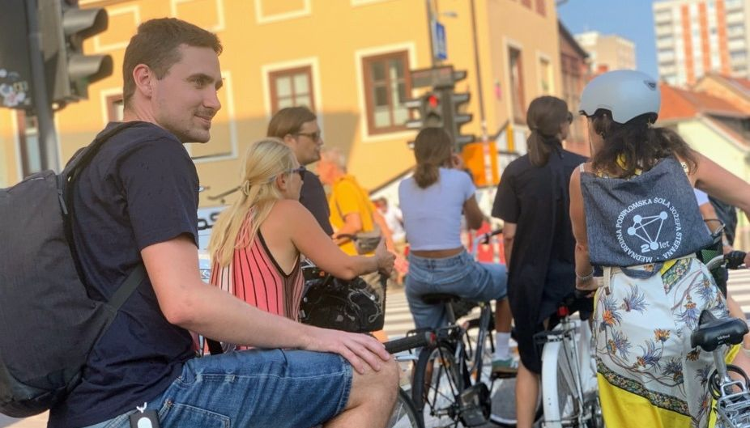
Contents
How is citizen science supported as public scientific policy in Slovenia?
How does the Slovenian Citizen Science Network operate?
Future of the Network
Source: Arhiv UKLL
CeOS_SE, Zagreb, 30th October, 2024

Slide 3
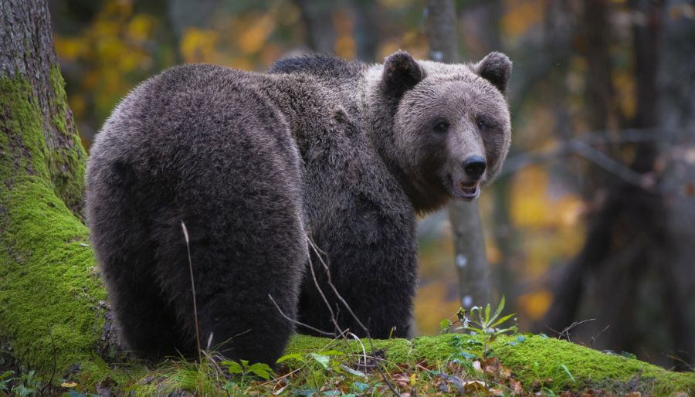
Citizen Science as a Science Policy in Slovenia
European Union:
The European Research Area (ERA) was reformed in 2022 with two important pillars:
Early and open sharing of research results and
Socially engaged science.
Slovenia:
2021 Act on Scientific Research and Innovation Activities
2023 Open Science Decree
Both these acts mention citizen science as a public science policy
Source: dinalpbear.eu
CeOS_SE, Zagreb, 30th October, 2024

Slide 4
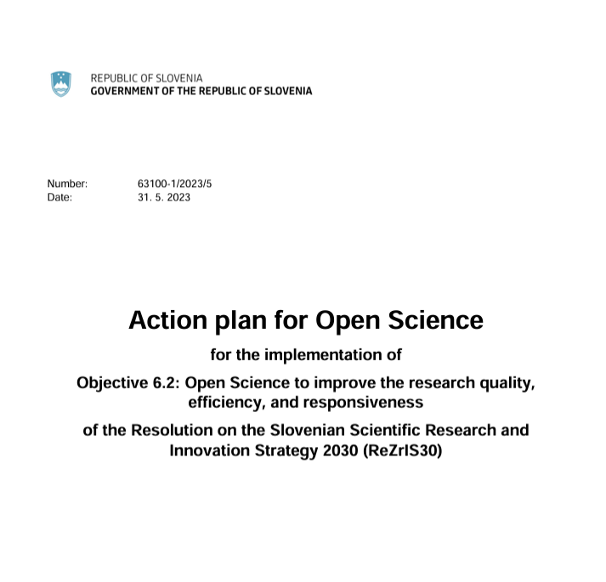
Open Science in Slovenia
The Slovenian legislation requires researchers to share all the results of their scientific work in open access by the FAIR principles.
This requires additional resources from researchers.
This is why the Slovenian Government has adopted an Open Science Action Plan, which provides more than €40 million for this purpose by 2030.
One of the activities (Action 6.2.5) in this Action Plan funded by the Slovenian Government is citizen science.
Source: https://www.openaire.eu/blogs/slovenia-government-adopted-the-action-plan-for-open-science
CeOS_SE, Zagreb, 30th October, 2024

Slide 5
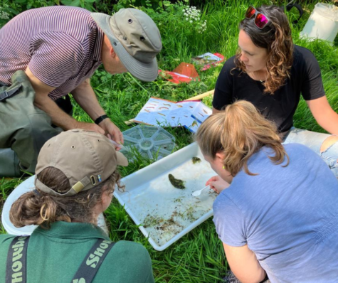
Funding
Network's activities (around €70,000 per year), mainly for staff (1 FTE) and overhead
The Slovenian Research and Innovation Agency will launch this year its first call for citizen science projects for about 500.000 €
Source: https://bristolavonriverstrust.org/citizen-science-river-health/
CeOS_SE, Zagreb, 30th October, 2024

Slide 6
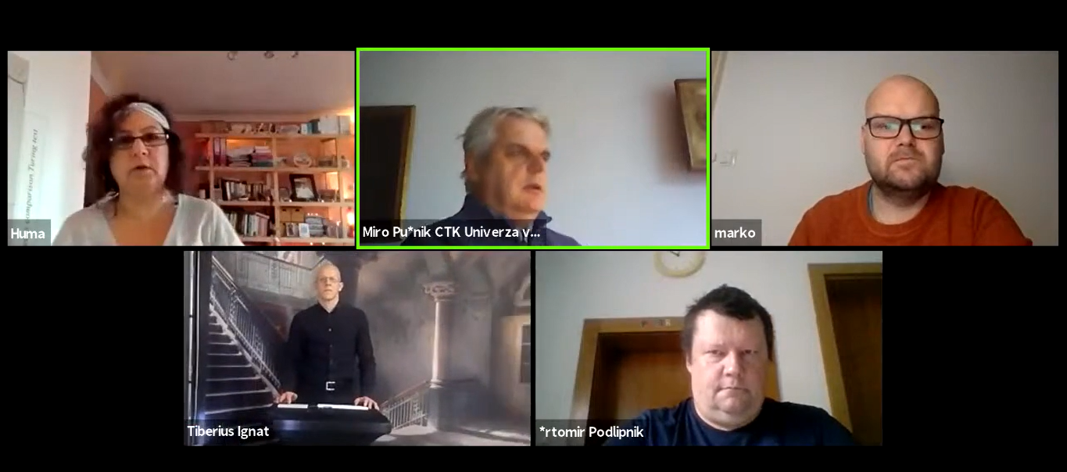
Activities of Central Technical Library at the University of Ljubljana (CTK)
LIBER
ECSA
makerspace
Focus on Open Science Ljubljana
Covid.si (2020)
wuhobrani
Web events, podcast
Source: Arhiv CTK
CeOS_SE, Zagreb, 30th October, 2024

Slide 7
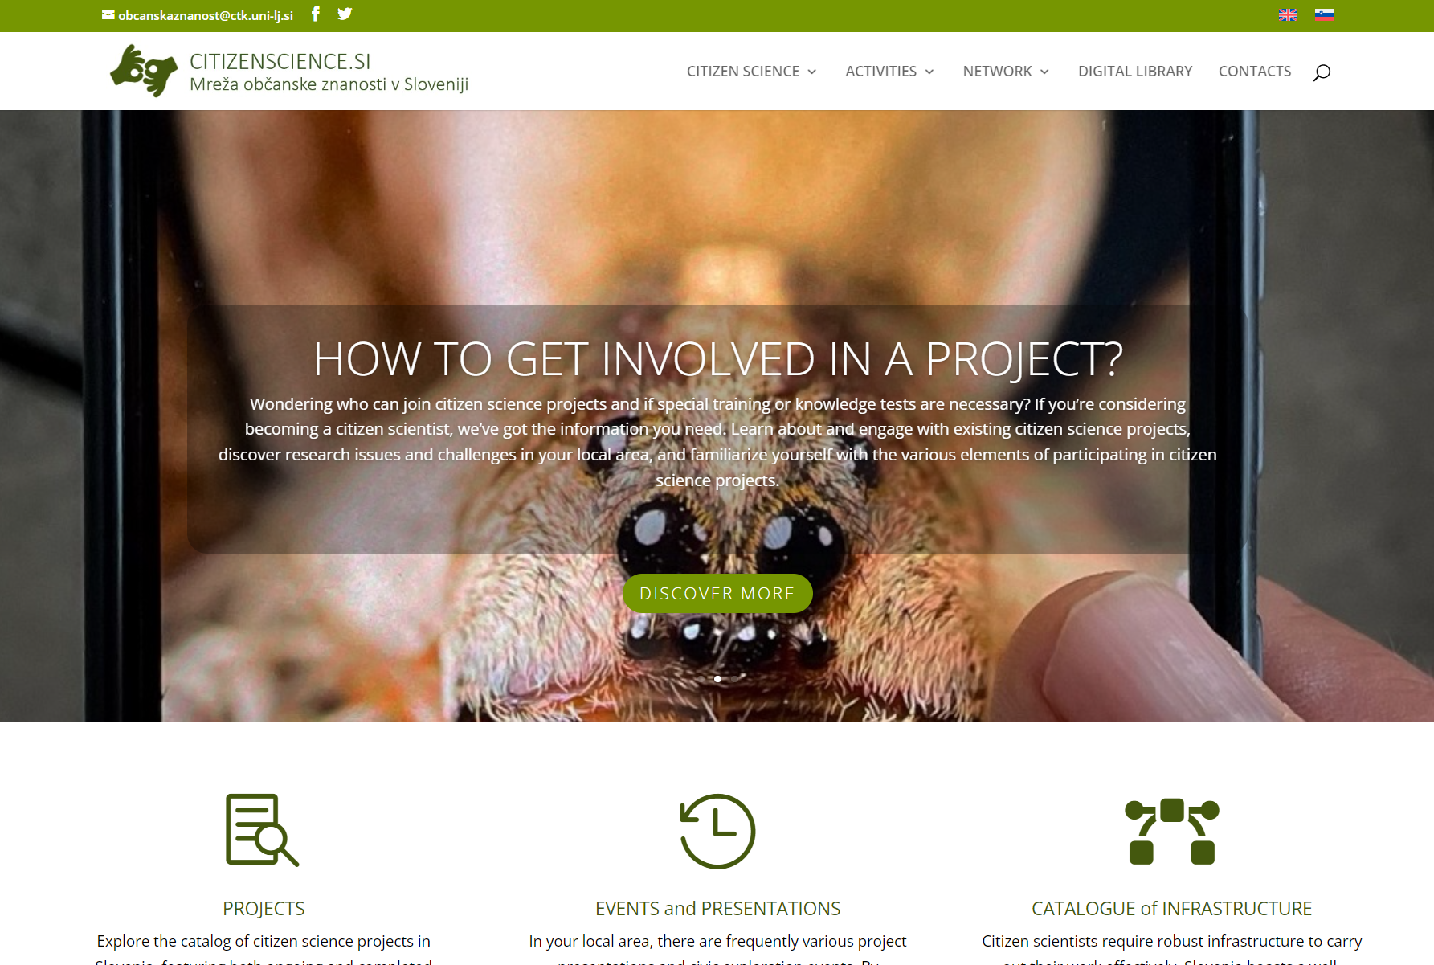
How we built Citizen Science Network
As part of this Action Plan, CTK has been tasked with setting up a citizen science network in Slovenia and two years ago, the network was established.
The first activities were:
looking for interested stakeholders and inviting them as partners,
setting up a portal citizenscience.si,
first hybrid meeting 20th July 2023 (13 partners)
network coordinator from Ljubljana City Library (Andreja Vovk Iskrić)
citizen science ambassador (dr. Zarja Muršič)
1st national event 15h November 2023
workgroups (marketing, event, libraries, handbook, strategy)
Source: https://citizenscience.si/en/
CeOS_SE, Zagreb, 30th October, 2024

Slide 8
Key Objectives of Citizen Science Network of Slovenia
So what are the key objectives of our portal?
To connect the academic community and the public
To increase scientific literacy and enable the general public to understand how science works
To contribute efforts in improving the world we live in
Source: ZNC
CeOS_SE, Zagreb, 30th October, 2024

Slide 9
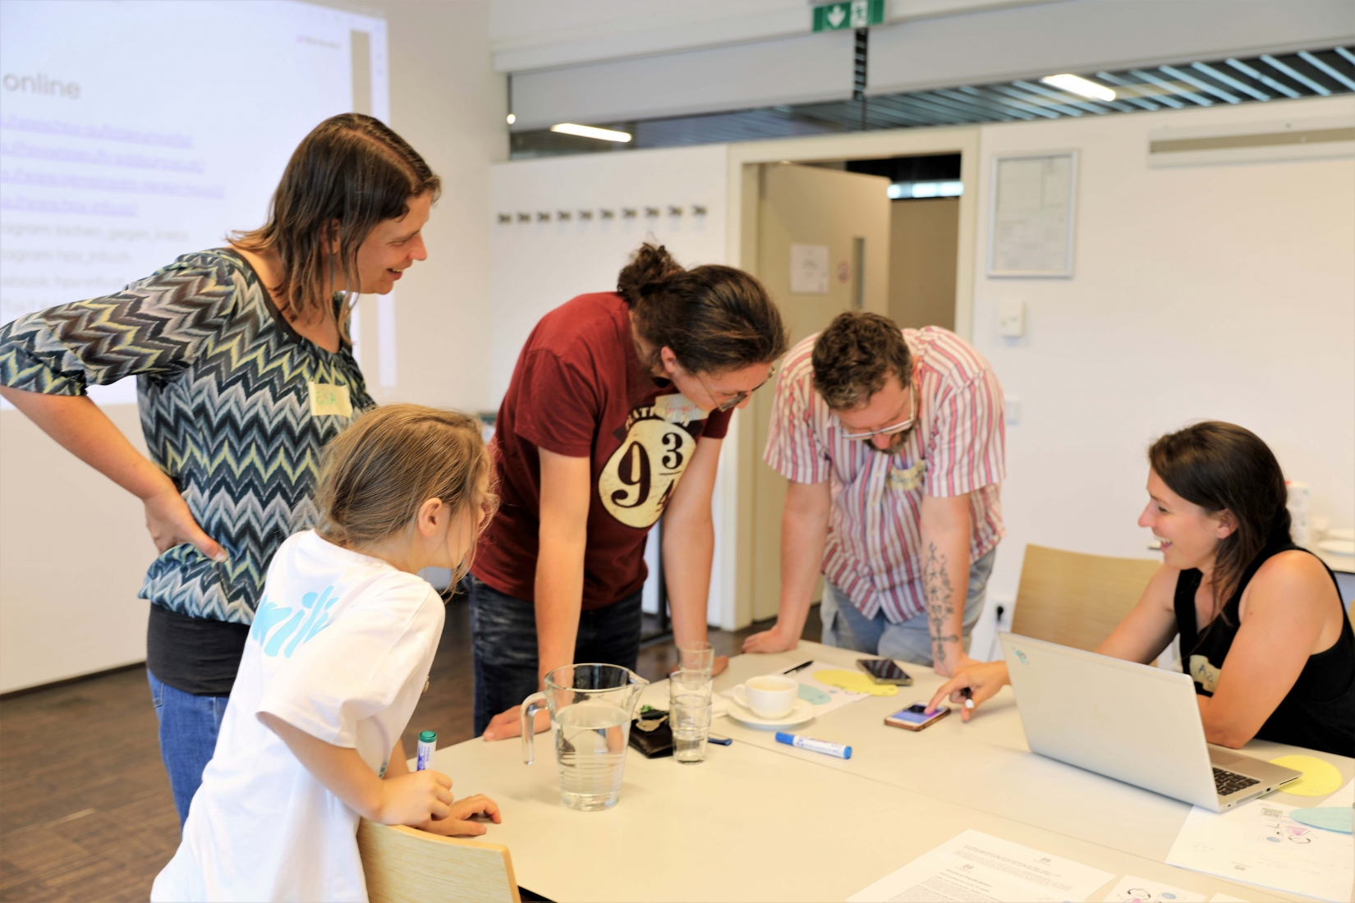
Stakeholders
When we designed the citizen science network, we systematically addressed four key stakeholders:
academic organisations and research institutes
(scientific) societies
third age groups
libraries, with a focus on public libraries
individuals
Source: Österreich forscht
CeOS_SE, Zagreb, 30th October, 2024

Slide 10
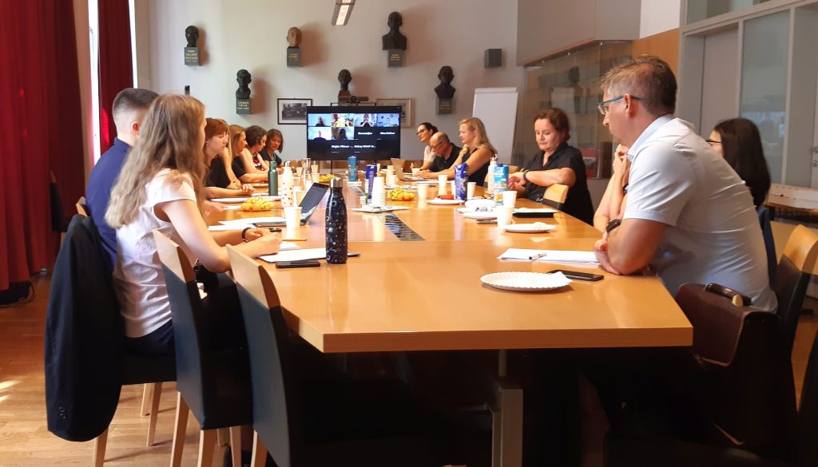
Network
The Citizen science network of Slovenia is an informal network of interested organisations and individuals with the common goal of working in the field of citizen science.
We work through regular meetings, where we plan joint activities such as projects updates, website maintenance, events organisation, etc.
An important rule of our community is that decisions are taken by consensus and not by vote.
The network currently has 39 members, from universities to associations and individuals.
Source: IRVD
CeOS_SE, Zagreb, 30th October, 2024

Slide 11
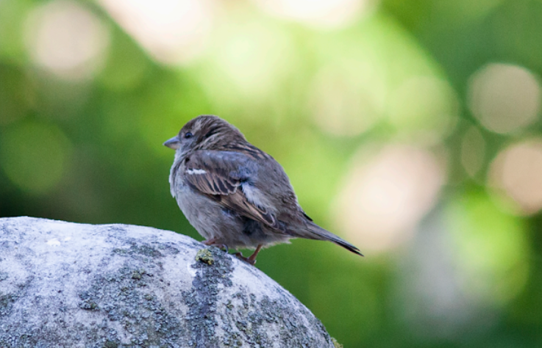
Contents on citizenscience.si
News
Basic information on citizen science
Open calls
Catalogue of citizen science projects
Trainings
Inventory of Open infrastructures
Toolkit
Digital library
Foto: Gašper Lešnik
CeOS_SE, Zagreb, 30th October, 2024

Slide 12
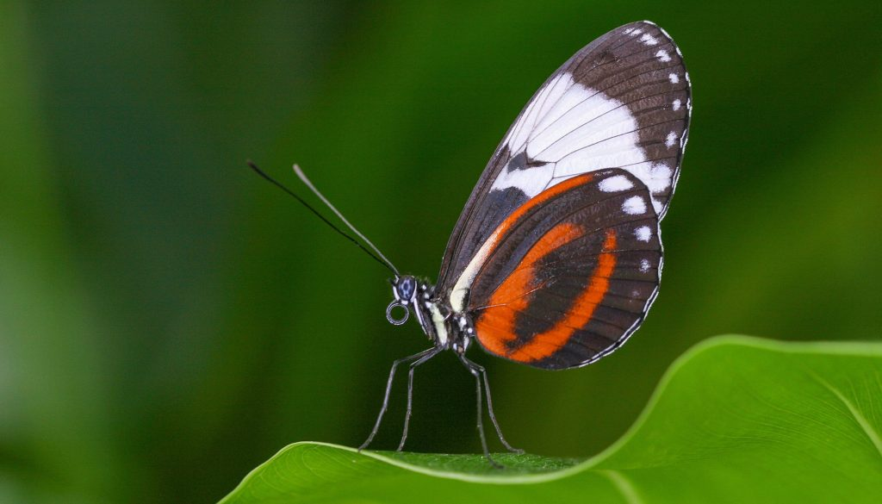
Catalogue of projects
Currently we have 65 projects in our catalogue in different fields and organised in different ways.
We have decided not to follow the strict principle that the organiser must be a professional researcher, but to welcome any project that works on basic scientific principles.
The projects in our collection are imported to the eu-citizen.science aggregator, which is of great importance for marketing and international cooperation.
Source:pexels
CeOS_SE, Zagreb, 30th October, 2024

Slide 13
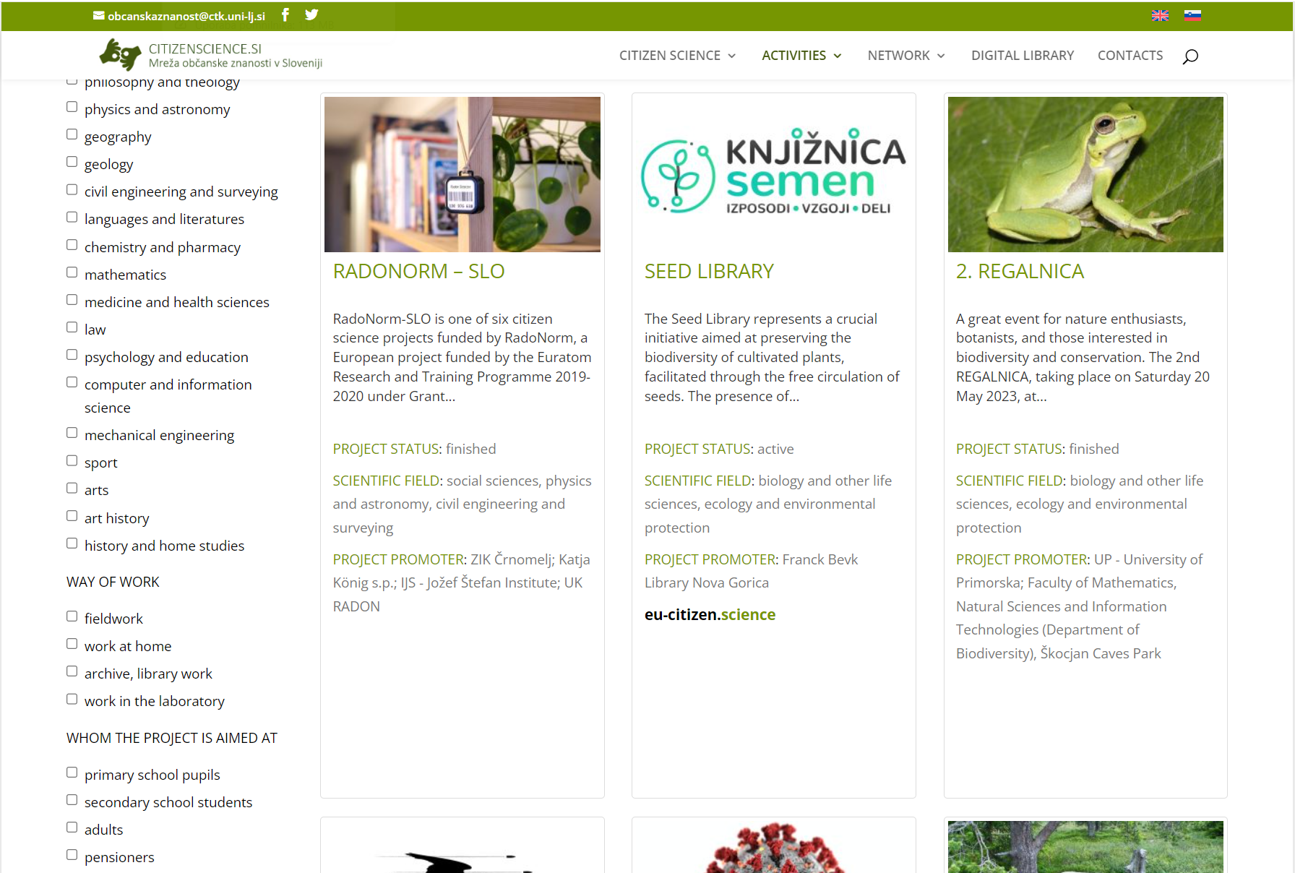
CeOS_SE, Zagreb, 30th October, 2024

Slide 14
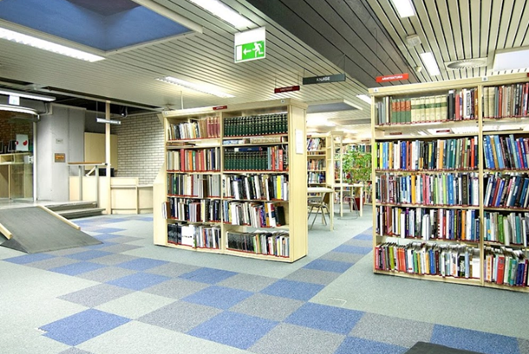
CTK support
Infrastructure
Marketing
Recruitment of citizen scientists for projects
Training for project managers
National observatory for citizen science
CeOS_SE, Zagreb, 30th October, 2024

Slide 15
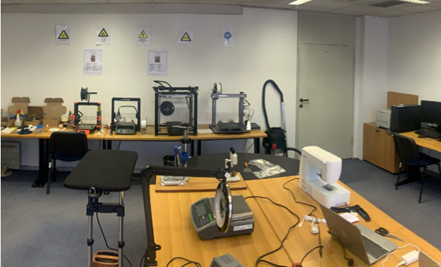
Open infrastructure for research
Free membership
Information resources and advice
Bibliographic support
Repository DiRROS
Creative space
Library of things
Room for meetings
CeOS_SE, Zagreb, 30th October, 2024

Slide 16
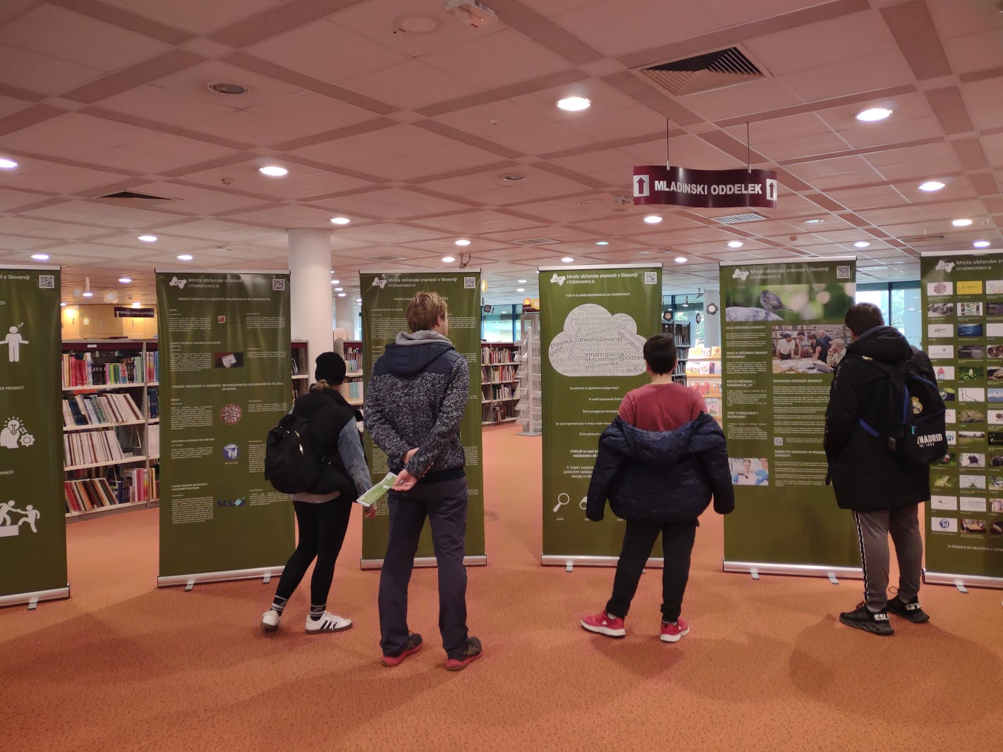
Future of our Network
Comprehensive training program
Printed guide / toolkit
Intensive marketing activities
Overlay journal
Email newsletter
Local municipalities
Private sector
CeOS_SE, Zagreb, 30th October, 2024

Slide 17
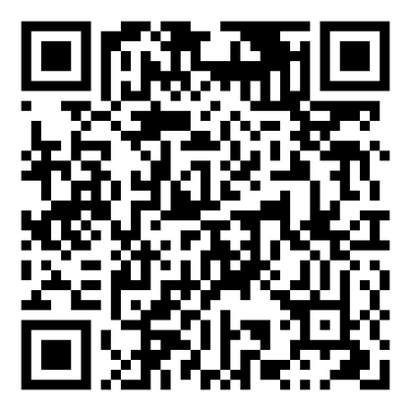
2nd Citizen science Day
CeOS_SE, Zagreb, 30th October, 2024

Slide 18
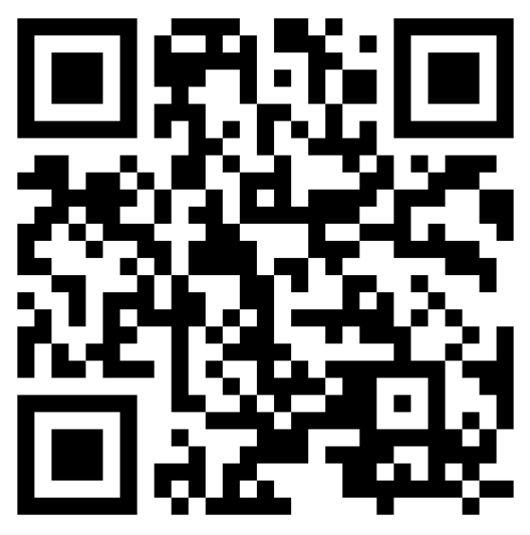
We would love to hear from you!
Til Mlakar, CTK, citizen science, website;
Mitja V. Iskrić, CTK, open data, open publications, citizen science, creative space, public relations;
Andreja Vovk Iskrić, Ljubljana City Library, Network coordinator;
CeOS_SE, Zagreb, 30th October, 2024

